Slide 1
Chapter 8 Mapping a Conceptual Design into a Logical Design

Slide 2
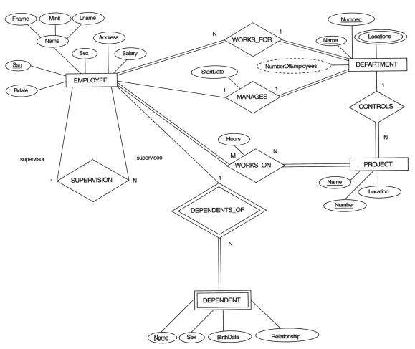
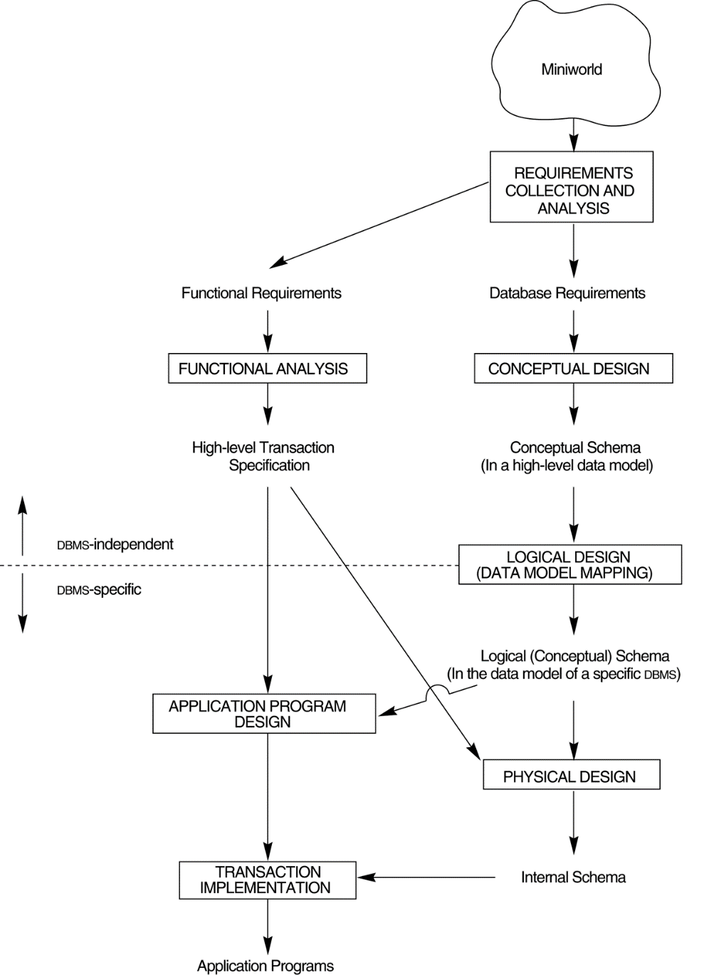
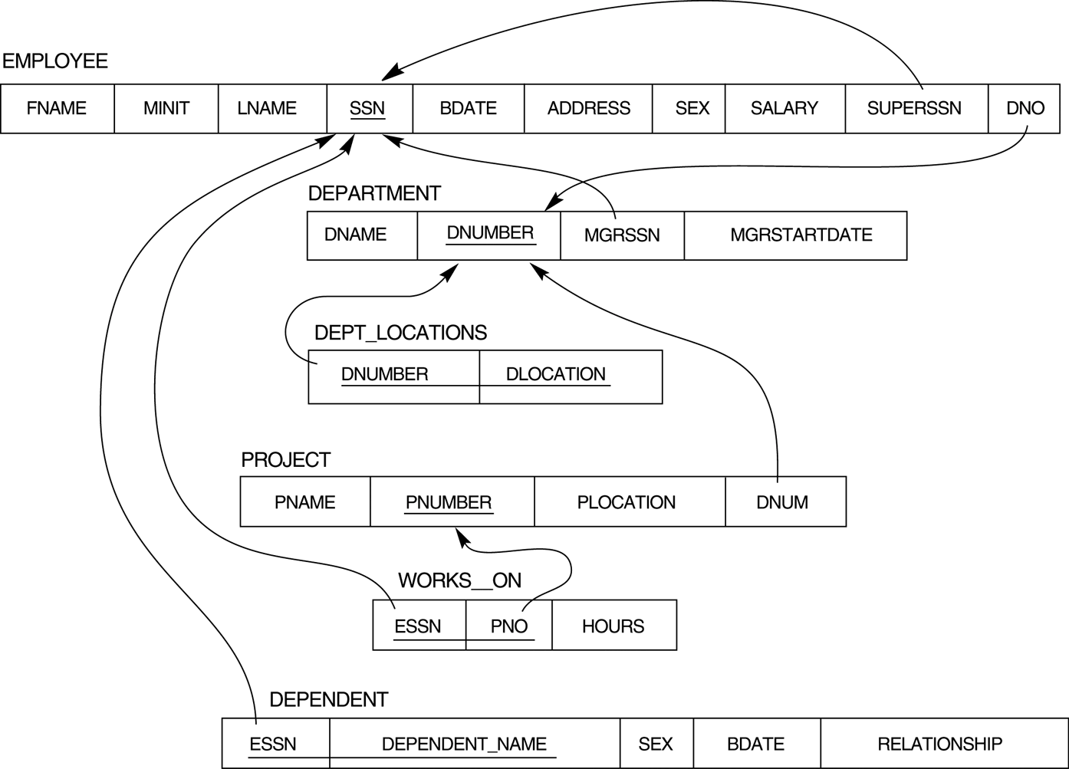

Main phases of database system design
Data Requirements
Conceptual design
(ER Model)
Conceptual schema
Ch.7
Logical design
(Relational Model)
Ch.8
Ch.4
Logical schema
Physical design

Slide 3

Chapter Outline
ER-to-Relational Mapping Algorithm
Step 1: Mapping of Regular Entity Types
Step 2: Mapping of Weak Entity Types
Step 3: Mapping of Binary 1:1 Relationship Types
Step 4: Mapping of Binary 1:N Relationship Types.
Step 5: Mapping of Binary M:N Relationship Types.
Step 6: Mapping of Multivalued attributes.
Step 7: Mapping of N-ary Relationship Types.
Mapping EER Model Constructs to Relations
Step 8: Options for Mapping Specialization or Generalization.
Step 9: Mapping of Union Types (Categories).

Slide 4
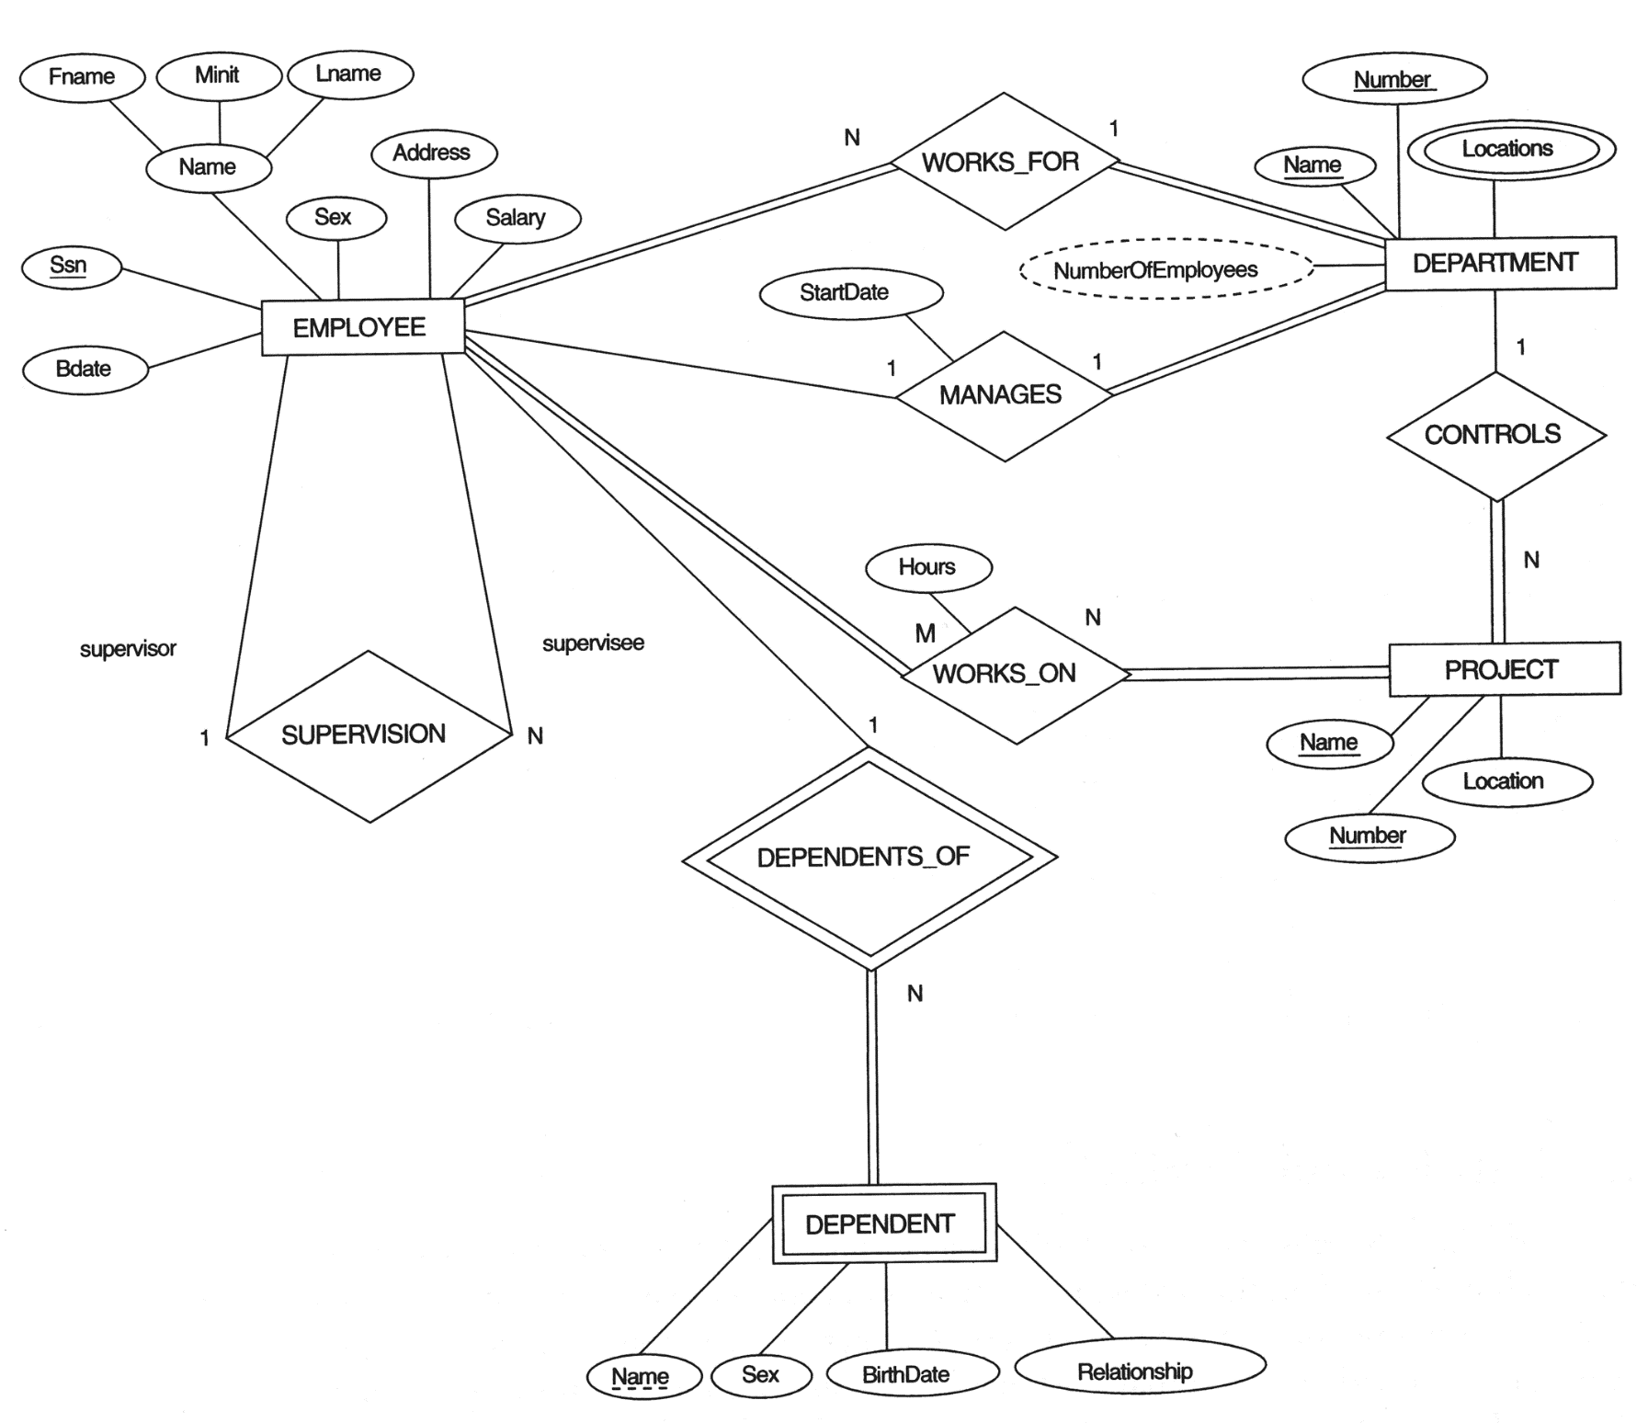
The ER conceptual schema diagram for the COMPANY database.
Functional Dependency

Slide 5

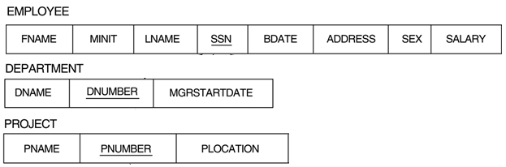
ER-to-Relational Mapping Algorithm
Step 1: Mapping of Regular(一般) Entity Types.
For each regular (strong) entity type E in the ER schema, create a relation R
that includes all the simple attributes of E.
Choose one of the key attributes of E as the primary key for R.
If the chosen key of E is composite, the set of simple attributes that form it will together form the primary key of R.
Example:
We create the relations EMPLOYEE, DEPARTMENT, and PROJECT in the relational schema corresponding to the regular entities in the ER diagram.
SSN, DNUMBER, and PNUMBER are the primary keys for the relations EMPLOYEE, DEPARTMENT, and PROJECT as shown.

Slide 6
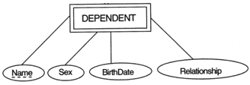

ER-to-Relational Mapping Algorithm
Step 2: Mapping of Weak Entity Types
For each weak entity type W in the ER schema with owner entity type E,
create a relation R and include all simple attributes
(or simple components of composite attributes) of W as attributes of R.
In addition, include as foreign key attributes of R the primary key attribute(s) of the relation(s) that correspond to the owner entity type(s).
The primary key of R is the combination of the primary key(s) of the owner(s) and the partial key of the weak entity type W, if any.
Example:
Create the relation DEPENDENT in this step to correspond to the weak entity type DEPENDENT. Include the primary key SSN of the EMPLOYEE relation as a foreign key attribute of DEPENDENT (renamed to ESSN).
The primary key of the DEPENDENT relation is the combination {ESSN, DEPENDENT_NAME} because DEPENDENT_NAME is the partial key of DEPENDENT.
Partial key (可能會重複)
from owner entity type(s)

Slide 7
ER-to-Relational Mapping Algorithm
Step 3: Mapping of Binary 1:1 Relationship Types
For each binary 1:1 relationship type R in the ER schema, identify the relations S and T that correspond to the entity types participating in R.
There are three possible approaches:
(1) Foreign key approach:
Choose one of the relations-S, say-and include a foreign key in S the primary key of T. It is better to choose an entity type with total participation in R in the role of S.
Example: 1:1 relation MANAGES is mapped by choosing the participating entity type DEPARTMENT to serve in the role of S, because its participation in the MANAGES relationship type is total.
(2) Merged relation option: (把全部集合成一個releation)
An alternate mapping of a 1:1 relationship type is possible by merging the two entity types and the relationship into a single relation. This may be appropriate when both participations are total.
(3) Cross-reference or relationship relation option: (把全部拆開成releation)
The third alternative is to set up a third relation R for the purpose of cross-referencing the primary keys of the two relations S and T representing the entity types.
SSN ---
Name ---
EMP
1
1
DEPT
--- DNUM
--- DeptName
MANAGE
1000 e_{i}
5 d_{i}

Slide 8
ER-to-Relational Mapping Algorithm
Step 4: Mapping of Binary 1:N Relationship Types.
For each regular binary 1:N relationship type R, identify the relation S that represent the participating entity type at the N-side of the relationship type.
Include as foreign key in S the primary key of the relation T that represents the other entity type participating in R.
Include any simple attributes of the 1:N relation type as attributes of S.
Example: 1:N relationship types WORKS_FOR, CONTROLS, and SUPERVISION in the figure. For WORKS_FOR we include the primary key DNUMBER of the DEPARTMENT relation as foreign key in the EMPLOYEE relation and call it DNO.
SSN ---
Name ---
EMP
N
1
DEPT
--- DNUMBER
--- DeptName
Works-for
1000 e_{i}
5 d_{i}

Slide 9

ER-to-Relational Mapping Algorithm
Step 5: Mapping of Binary M:N Relationship Types.
For each regular binary M:N relationship type R, create a new relation S to represent R.
Include as foreign key attributes in S the primary keys of the relations that represent the participating entity types; their combination will form the primary key of S.
Also include any simple attributes of the M:N relationship type (or simple components of composite attributes) as attributes of S.
Example:
The M:N relationship type WORKS_ON from the ER diagram is mapped by creating a relation WORKS_ON in the relational database schema. The primary keys of the PROJECT and EMPLOYEE relations are included as foreign keys in WORKS_ON and renamed PNO and ESSN, respectively.
Attribute HOURS in WORKS_ON represents the HOURS attribute of the relation type. The primary key of the WORKS_ON relation is the combination of the foreign key attributes {ESSN, PNO}.
SSN ---
Name ---
M
N
PROJ
--- PNO
--- PName
EMP
WORK-ON
1000 e_{i}
hours
8 p_{i}

Slide 10

ER-to-Relational Mapping Algorithm
Step 6: Mapping of Multivalued attributes.
For each multivalued attribute A, create a new relation R. This relation R will include an attribute corresponding to A, plus the primary key attribute K-as a foreign key in R-of the relation that represents the entity type of relationship type that has A as an attribute.
The primary key of R is the combination of A and K. If the multivalued attribute is composite, we include its simple components.
Example:
The relation DEPT_LOCATIONS is created. The attribute DLOCATION represents the multivalued attribute LOCATIONS of DEPARTMENT, while DNUMBER-as foreign key-represents the primary key of the DEPARTMENT relation. The primary key of R is the combination of {DNUMBER, DLOCATION}.
DNUMBER ---
DeptName ---
DEPT
LOCATIONS

Slide 11

Logical Database Design
ER diagram
Mapping
Relational Schema
(DB structure)

Slide 12
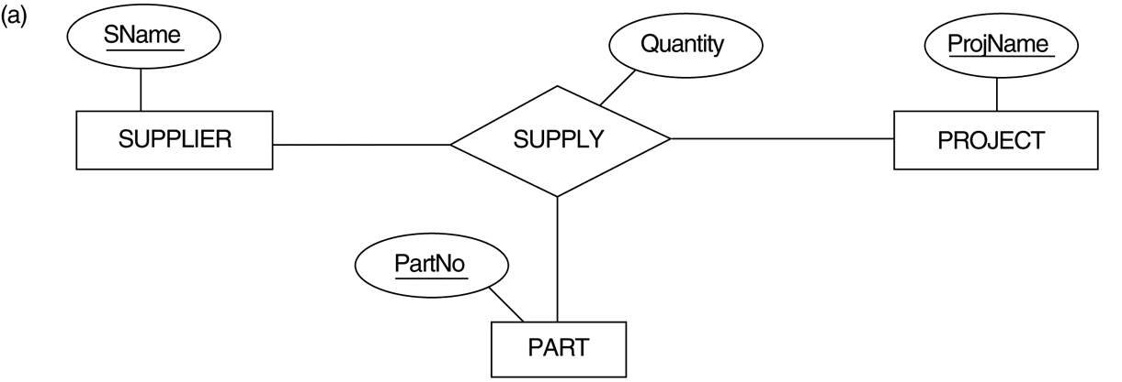
ER-to-Relational Mapping Algorithm
Step 7: Mapping of N-ary Relationship Types.
For each n-ary relationship type R, where n > 2, create a new relation S to represent R.
Include as foreign key attributes in S the primary keys of the relations that represent the participating entity types.
Also include any simple attributes of the n-ary relationship type (or simple components of composite attributes) as attributes of S.
Example: The relationship type SUPPY in the ER below. This can be mapped to the relation SUPPLY shown in the relational schema, whose primary key is the combination of the three foreign keys {SNAME, PARTNO, PROJNAME}

Slide 13
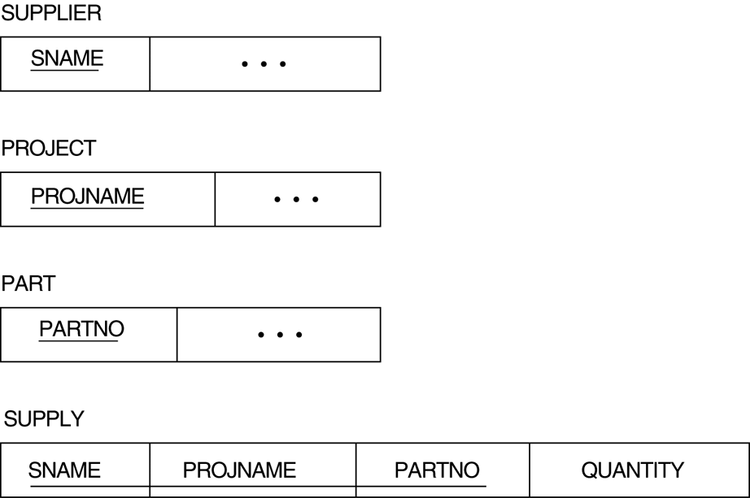
Mapping the n-ary relationship type SUPPLY to a new relation including the primary keys of the relations that represent the participating entity types.
Ternary relationship types. (a) The SUPPLY relationship.
Mapping

Slide 14
Summary of Mapping constructs and constraints
Table 7.1 Correspondence between ER and Relational Models
ER Model Relational Model
Entity type “Entity” relation
1:1 or 1:N relationship type Foreign key (or “relationship” relation)
M:N relationship type “Relationship” relation and two foreign keys
n-ary relationship type “Relationship” relation and n foreign keys
Simple attribute Attribute
Composite attribute Set of simple component attributes
Multivalued attribute Relation and foreign key
Value set Domain
Key attribute Primary (or secondary) key

Slide 15
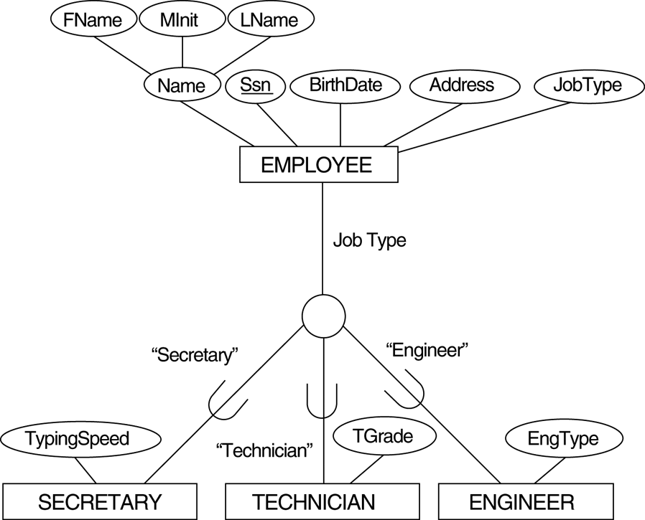
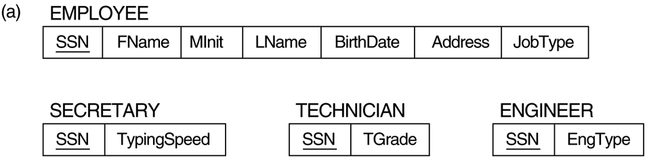
EER diagram notation for an attribute-defined specialization on JobType.
Options for mapping specialization or generalization. (a) Mapping the EER schema using option 8A.
separate (8A)
d
works for any specialization

Slide 16
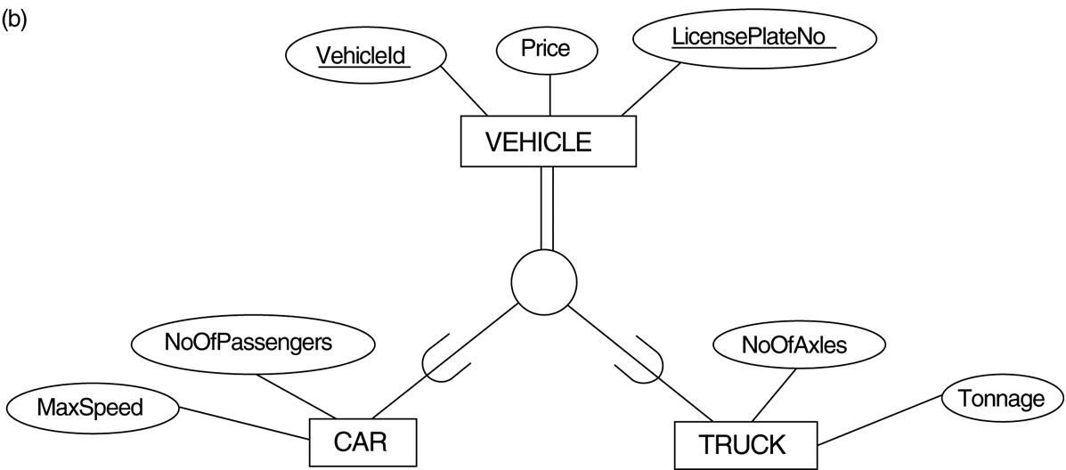
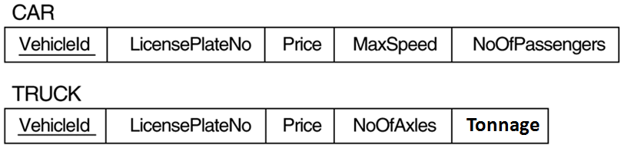
Generalization. (b) Generalizing CAR and TRUCK into the superclass VEHICLE.
Options for mapping specialization or generalization. (b) Mapping the EER schema using option 8B.
Downward merge (8B)
d
Works only for “total” participation

Slide 17
Mapping EER Model Constructs to Relations
Step8: Options for Mapping Specialization or Generalization.
Convert each specialization with m subclasses {S₁, S₂,….,S_{m}} and generalized superclass C, where the attributes of C are {k,a₁,…a_{n}} and k is the (primary) key, into relational schemas using one of the four following options:
Option 8A: Multiple relations- Superclass and subclasses
Create a relation L for C with attributes Attrs(L) = {k,a₁,…a_{n}} and PK(L) = k. Create a relation L_{i} for each subclass S_{i}, 1 < i < m, with the attributesAttrs(L_{i}) = {k} U {attributes of S_{i}} and PK(L_{i})=k.
This option works for any specialization (total or partial, disjoint or over-lapping).
Option 8B: Multiple relations- Subclass relations only
Create a relation L_{i} for each subclass S_{i}, 1 < i < m, with the attributes Attr(L_{i}) = {attributes of S_{i}} U {k,a₁…,a_{n}} and PK(L_{i}) = k.
This option only works for a specialization whose subclasses are total (every entity in the superclass must belong to (at least) one of the subclasses).

Slide 18
EER diagram notation for an attribute-defined specialization on JobType.
Options for mapping specialization or generalization. (c) Mapping the EER schema using option 8C.
Upward merge (8C)
d

Slide 19
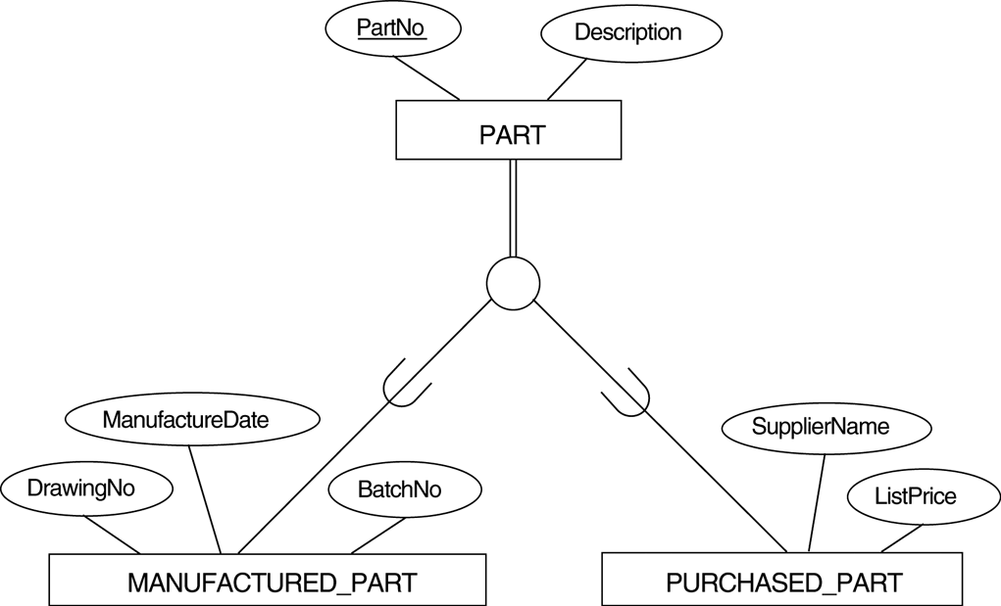
EER diagram notation for an overlapping (nondisjoint) specialization.
Options for mapping specialization or generalization. (d) Mapping using option 8D with Boolean type fields Mflag and Pflag.
Upward merge (8D)
o

Slide 20
Mapping EER Model Constructs to Relations
Option 8C: Single relation with one type attribute.
Create a single relation L with attributes Attrs(L) = {k,a₁,…a_{n}} U {attributes of S₁} U…U {attributes of S_{m}} U {t} and PK(L) = k.
The attribute t is called a type (or discriminating) attribute that indicates the subclass to which each tuple belongs
Option 8D: Single relation with multiple type attributes.
Create a single relation schema L with attributes Attrs(L) = {k,a₁,…a_{n}} U {attributes of S₁} U…U {attributes of S_{m}} U {t₁, t₂,…,t_{m}} and PK(L) = k.
Each t_{i}, 1 < i < m, is a Boolean type attribute indicating whether a tuple belongs to the subclass S_{i}.

Slide 21
Mapping EER Model Constructs to Relations
Mapping of Shared Subclasses (Multiple Inheritance)
A shared subclass, such as STUDENT_ASSISTANT, is a subclass of several classes, indicating multiple inheritance.
These classes must all have the same key attribute; otherwise, the shared subclass would be modeled as a category.
We can apply any of the options discussed in Step 8 to a shared subclass, subject to the restriction discussed in Step 8 of the mapping algorithm.
Below both 8C and 8D are used for the shared class STUDENT_ASSISTANT.

Slide 22
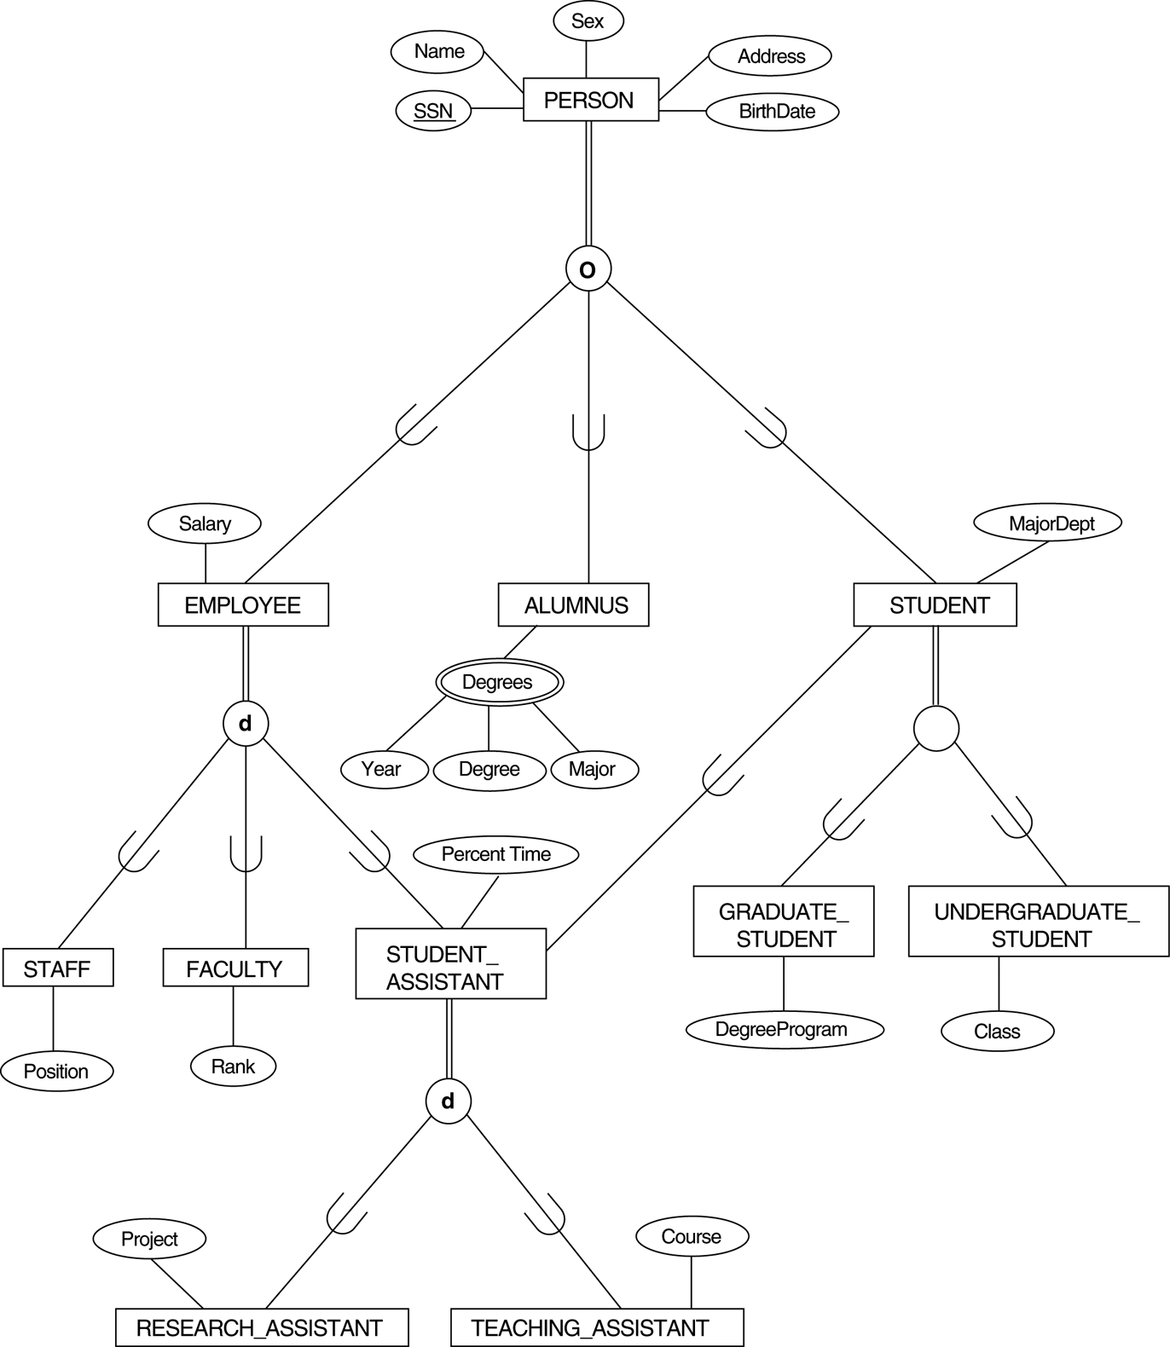
A specialization lattice with multiple inheritance for a UNIVERSITY database.
d

Slide 23
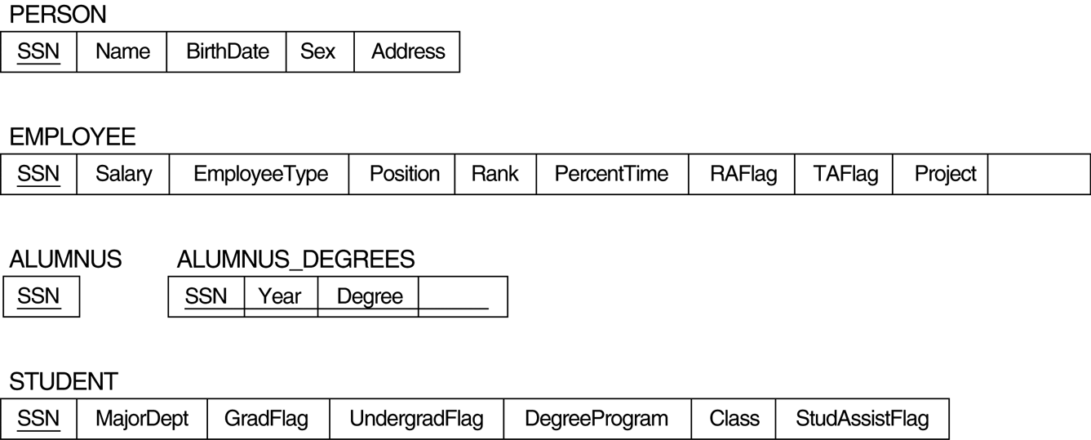

Mapping the EER specialization lattice using multiple options.
Course
Major
Shared-subclass:
STUDENT_ASSISTANT
d

Slide 24
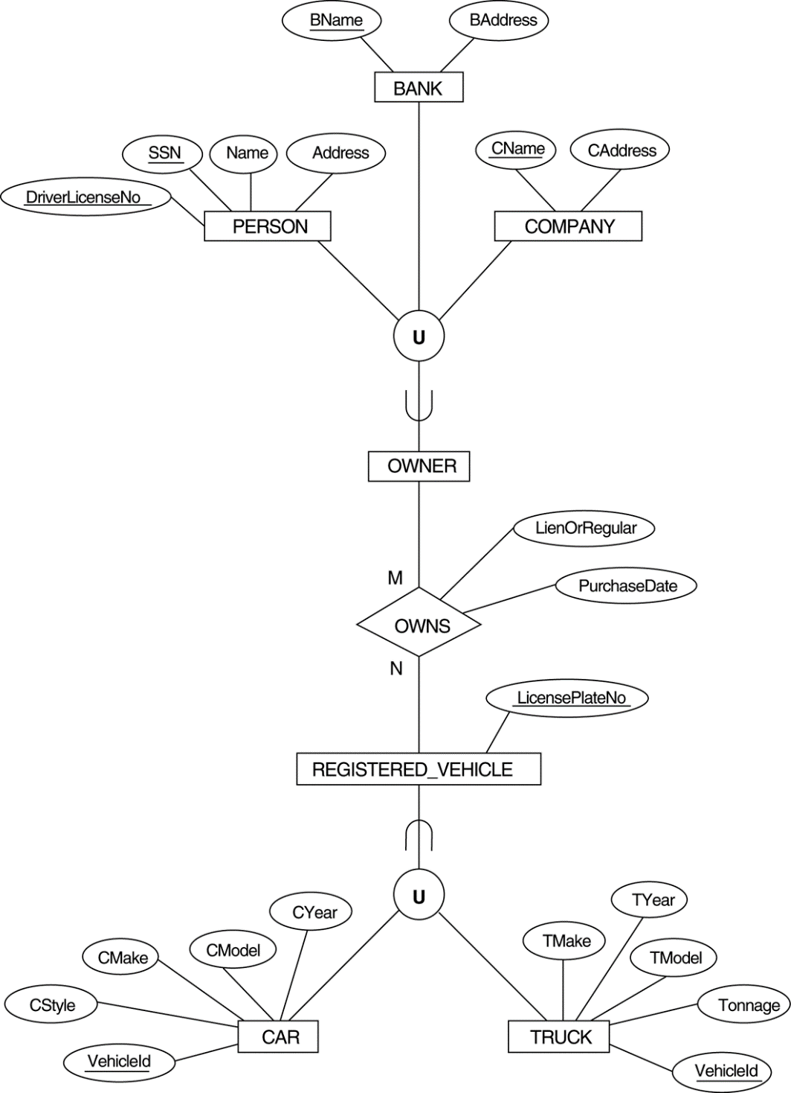
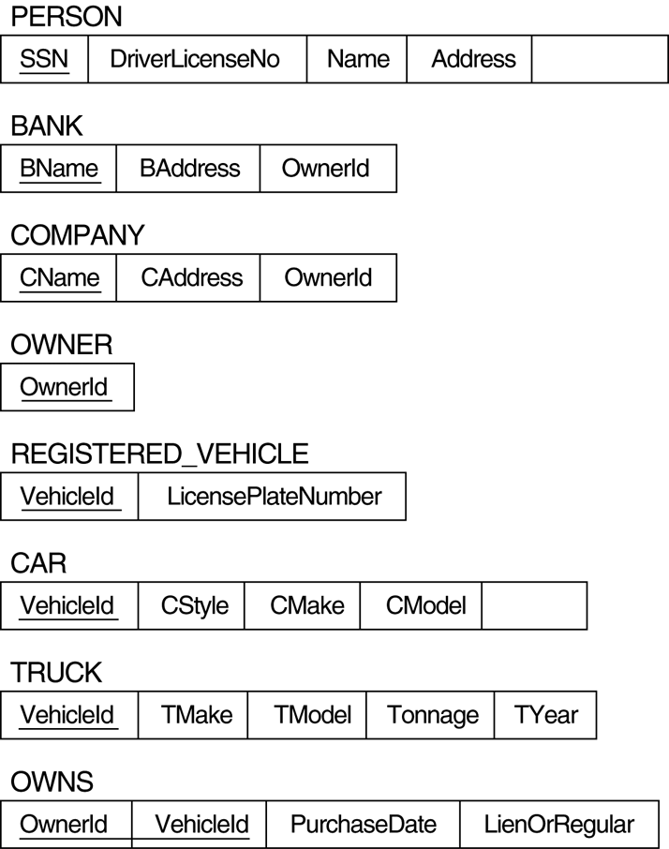
OwnerId
Two categories (union types): OWNER and REGISTERED_VEHICLE.
surrogate key
CYear

Slide 25
Mapping EER Model Constructs to Relations
Step 9: Mapping of Union Types (Categories).
For mapping a category whose defining superclass have different keys, it is customary to specify a new key attribute, called a surrogate key, when creating a relation to correspond to the category.
In the example below we can create a relation OWNER to correspond to the OWNER category and include any attributes of the category in this relation.
The primary key of the OWNER relation is the surrogate key, which we called OwnerId.

Slide 26
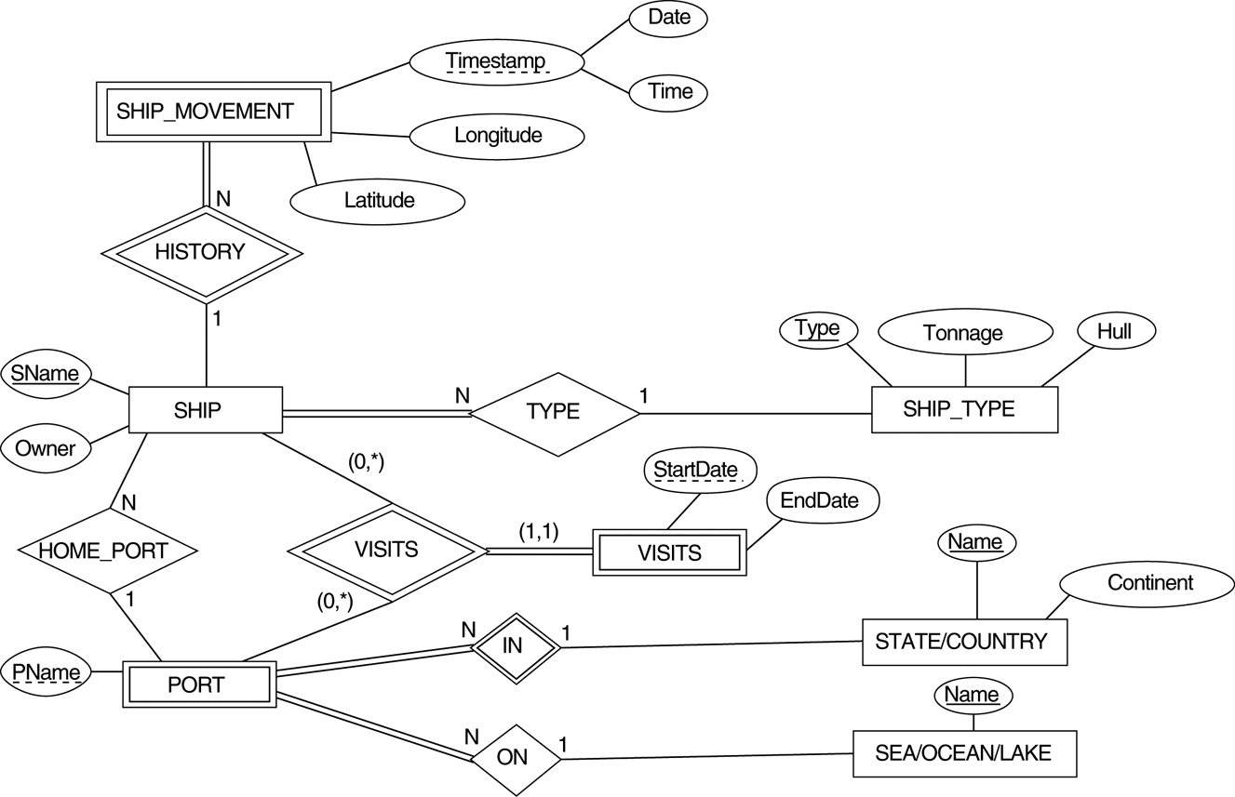
Mapping Exercise
An ER schema for a SHIP_TRACKING database.

